Slide 1
SOFTWARE ENGINEERING UNIT 1

Slide 2


What is Software Engineering?
Engineering approach to develop software.
Systematic collection of past experience:
  techniques,
  methodologies,
  guidelines.

Slide 3
Programs versus Software Products
Usually small in size
Author himself is sole user
Single developer
Lacks proper user interface
Lacks proper documentation
Ad hoc development.
Large
Large number of users
Team of developers
Well-designed interface
Well documented & user-manual prepared
Systematic development

Slide 4
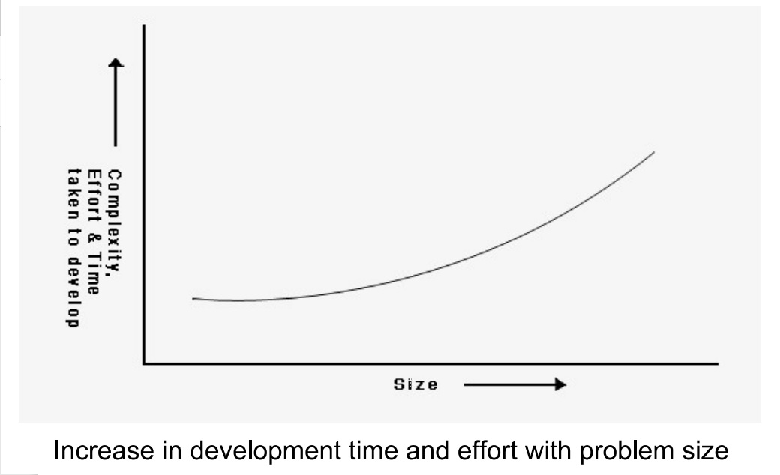
Software Complexity

Slide 5
Principle of Abstraction
The principle of abstraction implies that a problem can be simplified by omitting irrelevant details.

Slide 6
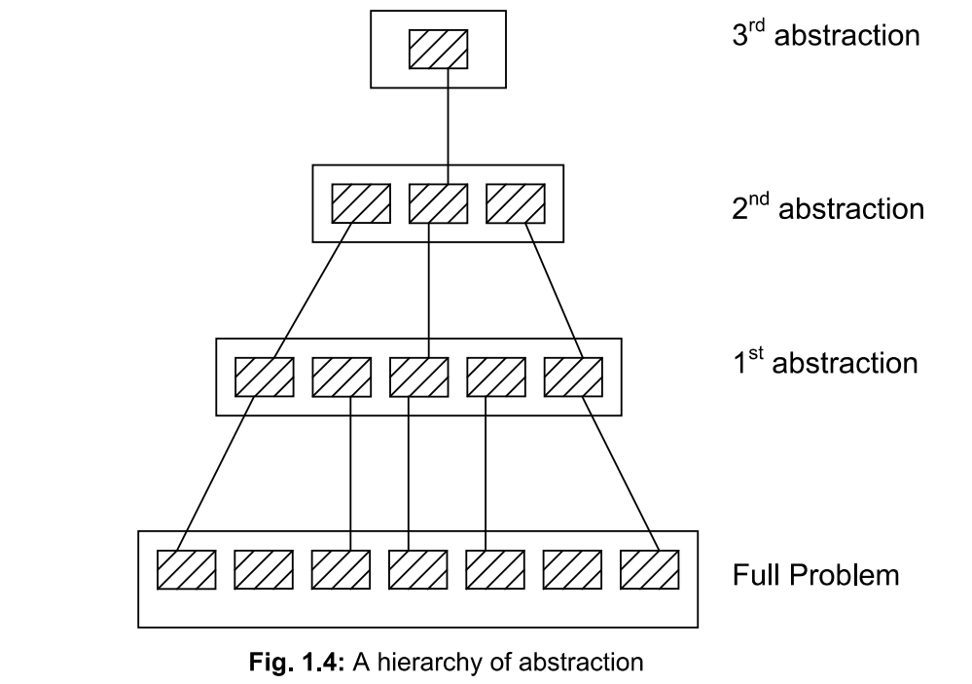
Hierarchy of Abstraction

Slide 7
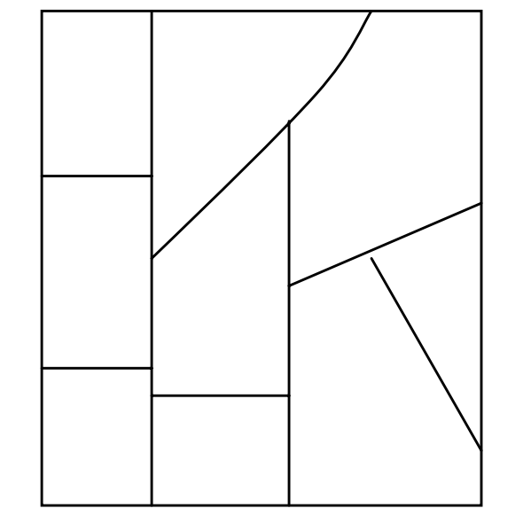
Decomposition
In this technique, a complex problem is divided in several small problems and then small problems are solved one by one.

Slide 8
Software Crisis
Software products:
  fail to meet user requirements.
  frequently crash.
  expensive.
  difficult to alter, debug, and enhance.
  often delivered late.
  use resources non-optimally.

Slide 9
Factors contributing to the software crisis
Larger problems,
Lack of adequate training in software engineering,
Increasing skill shortage,
Low productivity improvements.

Slide 10
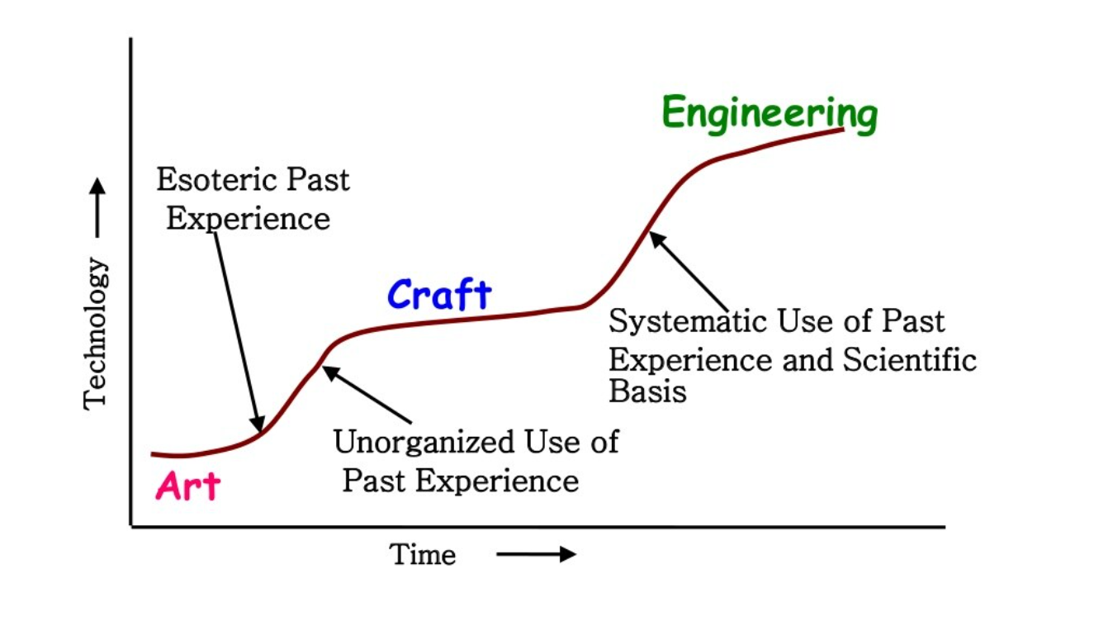
Evolution of Technology with Time

Slide 11
Evolution of Other Software Engineering Techniques
  life cycle models,
  specification techniques,
  project management techniques,
  testing techniques,
  debugging techniques,
  quality assurance techniques,
  software measurement techniques,
  CASE tools, etc.

Slide 12
Differences between the exploratory style and modern software development practices
Use of Life Cycle Models
Software is developed through several well-defined stages:
  requirements analysis and specification,
  design,
  coding,
  testing, etc.

Slide 13
Differences between the exploratory style and modern software development practices
Emphasis has shifted
  from error correction to error prevention.
Modern practices emphasize:
  detection of errors as close to their point of introduction as possible.

Slide 14
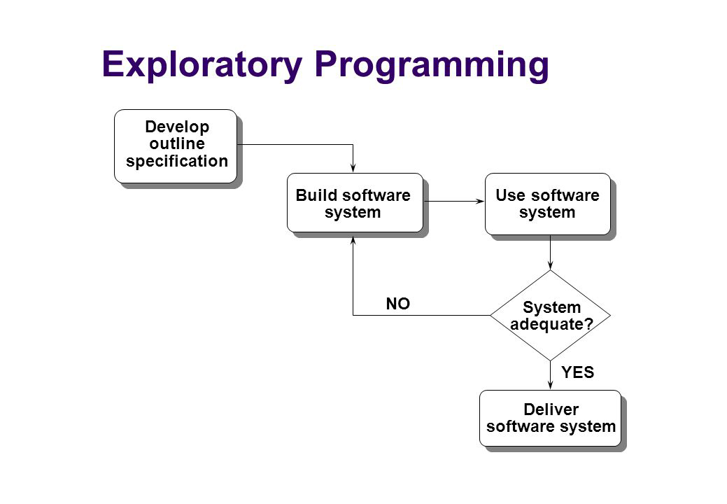
Differences between the exploratory style and modern software development practices

Slide 15
Differences between the exploratory style and modern software development practices (CONT.)
In exploratory style,
  errors are detected only during testing,
Now,
  focus is on detecting as many errors as possible in each phase of development.

Slide 16
Differences between the exploratory style and modern software development practices (CONT.)
During all stages of development process:
  Periodic reviews are being carried out
Software testing has become systematic:
  standard testing techniques are available.

Slide 17
Differences between the exploratory style and modern software development practices (CONT.)
Projects are being thoroughly planned:
  estimation,
  scheduling,
  monitoring mechanisms.
Use of CASE tools.

Slide 18
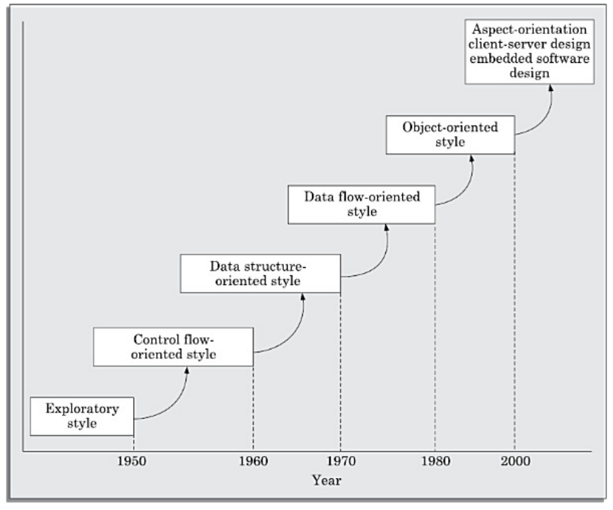
EMERGENCE OF SOFTWARE ENGINEERING

Slide 19
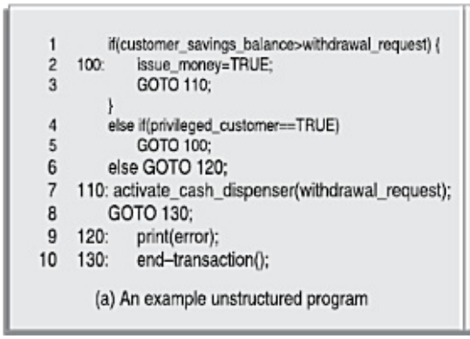
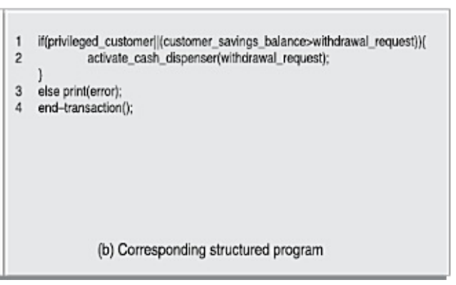
Control Flow-based Design
Flow Charting Technique:
  to write cost-effective and correct programs.
  to represent and design algorithms.
  easier to develop and understand.

Slide 20
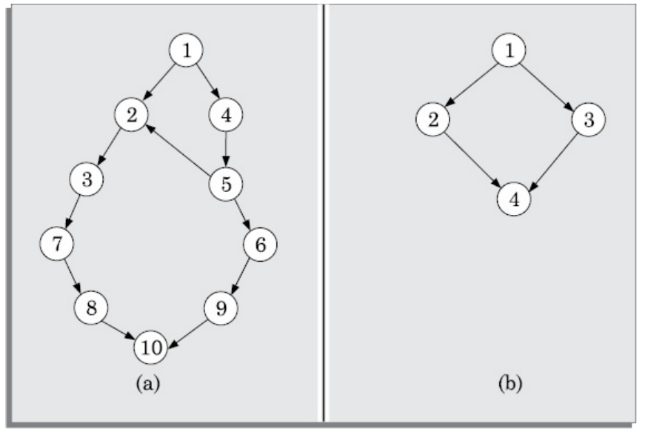
Example: Control Flow-based Design
Unstructured Program Structured Program
Program having a messy flow chart representation would indeed be difficult to understand and debug.

Slide 21
Data Structure-oriented Design
Need of Data Structure-oriented Design:
  with the advent of integrated circuits (ICs)
  to solve more complex problems.
Data structure- oriented design techniques :
  design data structures of program then design the code structure

Slide 22
Data Flow-oriented Design
Data flow-oriented techniques:
  major data items must be identified.
  Data is represented in DFDs (Data Flow Diagrams)
Need of Data Flow-oriented Design
  For very large scale integrated (VLSI) Circuits
  For new architectural concepts, complex and sophisticated software

Slide 23
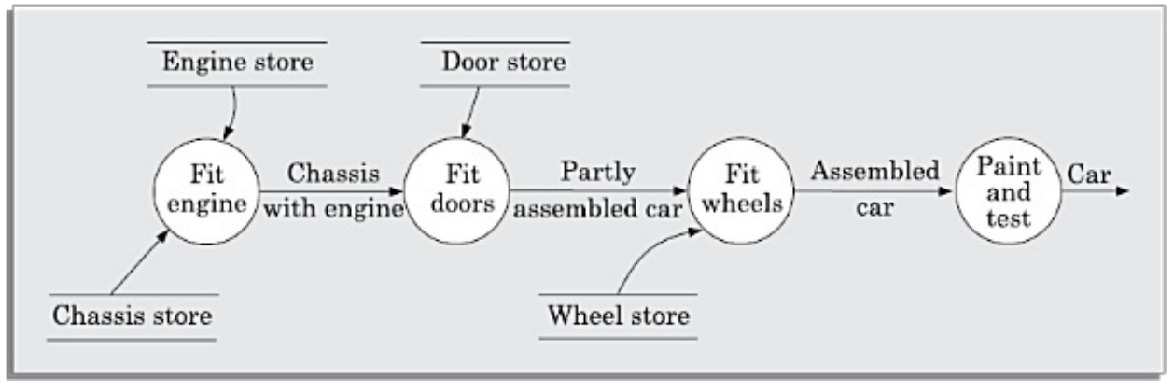
Example: Data Flow-oriented Design
Data Flow diagram of Car Assembly Plant

Slide 24
Object-Oriented Design (80s)
Object-oriented technique:
  natural objects (such as employees, pay-roll-register, etc.) occurring in a problem are first identified.
Relationships among objects:
  such as composition, reference, and inheritance are determined.

Slide 25
Life Cycle Model
A software life cycle model (or process model):
  a descriptive and diagrammatic model of software life cycle:
  identifies all the activities required for product development,
  establishes a precedence ordering among the different activities,
  Divides life cycle into phases.

Slide 26
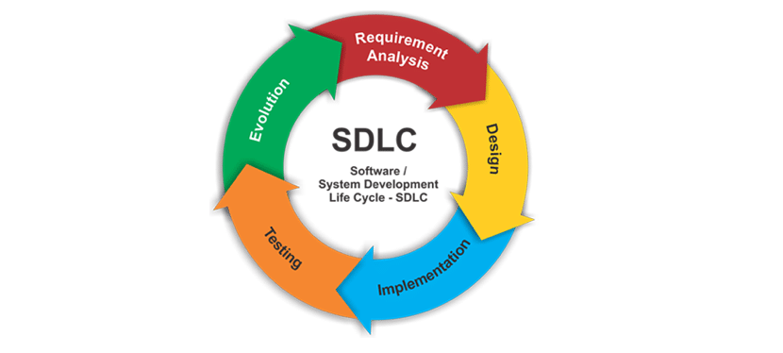
SDLC

Slide 27
SDLC Phases
Planning and Requirement analysis.
Defining Requirements
Designing the Software
Building or Developing the Software
Testing the Software
Deployment and Maintenance

Slide 28
Why Model Life Cycle ?
A written description:
  forms a common understanding of activities among the software developers.
  helps in identifying inconsistencies, redundancies in the development process.

Slide 29
Life Cycle Model (CONT.)
The development team must identify a suitable life cycle model:
  and then adhere to it.
  Primary advantage of adhering to a life cycle model:
    helps development of software in a systematic and disciplined manner.

Slide 30
Life Cycle Model (CONT.)
When a software product is being developed by a team:
  there must be a precise understanding among team members as to when to do what,
  otherwise it would lead to and project failure.

Slide 31
Life Cycle Model (CONT.)
A life cycle model:
  defines entry and exit criteria for every phase.
  A phase is considered to be complete:
    only when all its exit criteria's are satisfied.

Slide 32
Life Cycle Model (CONT.)
The phase exit criteria for the software requirements specification phase:
  Software Requirements Specification (SRS) document is complete, reviewed, and approved by the customer.
A phase can start:
  only if its phase-entry criteria have been satisfied.

Slide 33
Life Cycle Model (CONT.)
It becomes easier for software project managers:
  to monitor the progress of the project.

Slide 34
Life Cycle Model (CONT.)
Many life cycle models have been proposed.
We will confine our attention to a few important and commonly used models.
  classical waterfall model
  iterative waterfall,
  evolutionary,
  prototyping, and
  spiral model

Slide 35
Classical waterfall model

Slide 36
Classical Waterfall Model
Classical waterfall model divides life cycle into phases:
  feasibility study,
  requirements analysis and specification,
  design,
  coding and unit testing,
  integration and system testing,
  maintenance.

Slide 37
Classical Waterfall Model
Feasibility Study
Req. Analysis
Design
Coding
Testing
Maintenance

Slide 38
Classical Waterfall Model (CONT.)
Most organizations usually define:
  entry and exit criteria for every phase.
They also prescribe specific methodologies for:
  specification,
  design,
  testing,
  project management, etc.

Slide 39
Why to study Waterfall Model?
Every other model is based on Waterfall Model.
To develop an understanding toward various phases of software development.

Slide 40
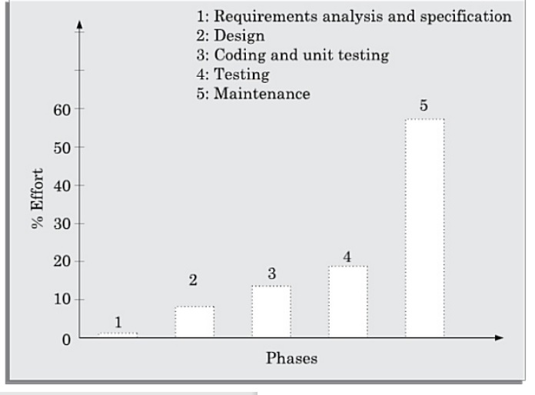
Classical Waterfall Model (CONT.)

Slide 41
Feasibility Study
Main aim of feasibility study:determine whether developing the product
  financially worthwhile
  technically feasible.
First roughly understand what the customer wants:
  different data which would be input to the system,
  processing needed on these data,
  output data to be produced by the system,
  various constraints on the behavior of the system.

Slide 42
Activities during Feasibility Study
Work out an overall understanding of the problem.
Formulate different solution strategies.
Examine alternate solution strategies in terms of:
    resources required,
    cost of development, and
    development time.

Slide 43
Activities during Feasibility Study
Perform a cost/benefit analysis:
  to determine which solution is the best.
  you may determine that none of the solutions is feasible due to:
    high cost,
    resource constraints,
    technical reasons.

Slide 44
Requirements Analysis and Specification
Aim of this phase:
  understand the exact requirements of the customer,
  document them properly.
Consists of two distinct activities:
  requirements gathering and analysis
  requirements specification.

Slide 45
Goals of Requirements Analysis
Collect all related data from the customer:
  analyze the collected data to clearly understand what the customer wants,
  find out any inconsistencies and incompleteness in the requirements,
  resolve all inconsistencies and incompleteness.

Slide 46
Requirements Gathering
Gathering relevant data:
  usually collected from the end-users through interviews and discussions.
  For example, for a business accounting software:
    interview all the accountants of the organization to find out their requirements.

Slide 47
Requirements Analysis (CONT.)
The data you initially collect from the users:
  would usually contain several contradictions and ambiguities:
  each user typically has only a partial and incomplete view of the system.

Slide 48
Requirements Analysis (CONT.)
Ambiguities and contradictions:
  must be identified
  resolved by discussions with the customers.
Next, requirements are organized:
  into a Software Requirements Specification (SRS) document.

Slide 49
Requirements Analysis (CONT.)
Engineers doing requirements analysis and specification:
  are designated as analysts.

Slide 50
Requirements Specification
Organizing requirement analysis into SRS
Important content of document
  Functional Requirements
  Non - Functional Requirements
  The goal of implementation

Slide 51
Design
Design phase transforms requirements specification:
  into a form suitable for implementation in some programming language.

Slide 52
Design
In technical terms:
  during design phase, software architecture is derived from the SRS document.
Two design approaches:
  traditional approach,
  object oriented approach.

Slide 53
Traditional Design Approach
Consists of two activities:
  Structured analysis
  Structured design

Slide 54
Structured Analysis Activity
Identify all the functions to be performed.
Identify data flow among the functions.
Decompose each function recursively into sub-functions.
  Identify data flow among the subfunctions as well.

Slide 55
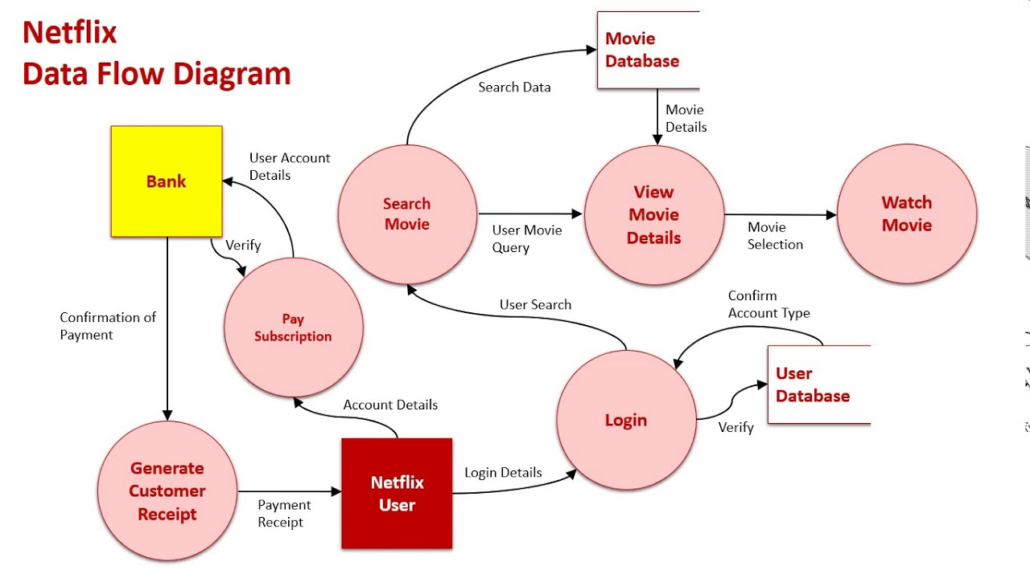
Structure Analysis (cont.)

Slide 56
Structured Analysis (CONT.)
Carried out using Data flow diagrams (DFDs).
After structured analysis, carry out structured design:
  architectural design (or high-level design)
  detailed design (or low-level design).

Slide 57
Structured Design
High-level design:
  decompose the system into modules,
  represent relationships among the modules.
Detailed design:
  different modules designed in greater detail:
    data structures and algorithms for each module are designed.

Slide 58
Object Oriented Design
First identify various objects (real world entities) occurring in the problem:
  identify the relationships among the objects.
  For example, the objects in a pay-roll software may be:
    employees,
    managers,
    pay-roll register,
    Departments, etc.

Slide 59
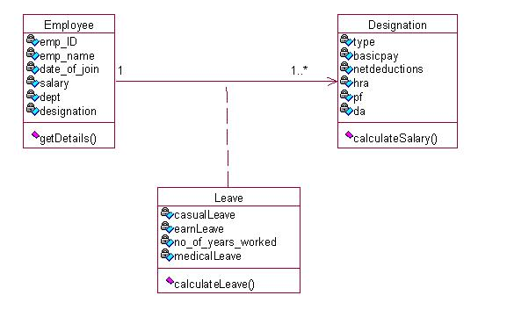
Object Oriented Design

Slide 60
Object Oriented Design (CONT.)
Object structure
  further refined to obtain the detailed design.
OOD has several advantages:
  lower development effort,
  lower development time,
  better maintainability.

Slide 61
Implementation
Purpose of implementation phase (coding phase):
  translate software design into source code.

Slide 62
Implementation
During the implementation phase:
  each module of the design is coded,
  each module is unit tested
    tested independently as a stand alone unit, and debugged,
  each module is documented.

Slide 63
Implementation (CONT.)
The purpose of unit testing:
  test if individual modules work correctly.
The end product of implementation phase:
  a set of program modules that have been tested individually.

Slide 64
Integration and System Testing
Different modules are integrated in a planned manner:
  modules are almost never integrated in one shot.
  Normally integration is carried out through a number of steps.
During each integration step,
  the partially integrated system is tested.

Slide 65
Integration and System Testing
M1
M2
M3
M4

Slide 66
System Testing
After all the modules have been successfully integrated and tested:
  system testing is carried out.
Goal of system testing:
  ensure that the developed system functions according to its requirements as specified in the SRS document.

Slide 67
Maintenance
Maintenance of any software product:
  requires much more effort than the effort to develop the product itself.
  development effort to maintenance effort is typically 40:60.

Slide 68
Maintenance (CONT.)
Corrective maintenance:
  Correct errors which were not discovered during the product development phases.
Perfective maintenance:
  Improve implementation of the system
  enhance functionalities of the system.
Adaptive maintenance:
  Port software to a new environment,
    e.g. to a new computer or to a new operating system.

Slide 69
Drawbacks of classical water fall model
1. no feedback paths
2. difficult to accommodate changes
3. No overlapping of phases
4. Limited customer interactions

Slide 70
Question
What is the first step in the software development lifecycle?
a) System Design
b) Coding
c) System Testing
d) Preliminary Investigation and Analysis

Slide 71
Iterative Waterfall Model
Classical waterfall model is idealistic:
  assumes that no defect is introduced during any development activity.
  in practice:
    defects do get introduced in almost every phase of the life cycle.

Slide 72
Iterative Waterfall Model (CONT.)
Defects usually get detected much later in the life cycle:
  For example, a design defect might go unnoticed till the coding or testing phase.

Slide 73
Iterative Waterfall Model (CONT.)
Once a defect is detected:
  we need to go back to the phase where it was introduced
  redo some of the work done during that and all subsequent phases.
Therefore we need feedback paths in the classical waterfall model.

Slide 74
Iterative Waterfall Model (CONT.)
Feasibility Study
Req. Analysis
Design
Coding
Testing
Maintenance

Slide 75
Iterative Waterfall Model (CONT.)
Errors should be detected
  in the same phase in which they are introduced.
For example:
  if a design problem is detected in the design phase itself,
    the problem can be taken care of much more easily than, if it is identified at the end of the integration and system testing phase.

Slide 76
Phase containment of errors
The principle of detecting errors as close to its point of introduction as possible:
  is known as phase containment of errors.
Iterative waterfall model is most widely used model.
  Almost every other model is derived from the waterfall model.

Slide 77
NEXT CLASS : PROTOTYPING MODEL

Slide 78
Prototyping Model

Slide 79
Prototyping Model
Before starting actual development,
  a working prototype of the system should first be built.
A prototype is a toy implementation of a system:
  limited functional capabilities,
  low reliability,
  inefficient performance.

Slide 80
Prototyping Model (CONT.)
In many instances the client only has a general view of what is to be expected from the software product. In such a scenario where there is an absence of detailed information regarding the input to the system, the processing needs and the output requirements, the prototyping model may be employed.

Slide 81
Question
When we should choose Prototyping model?
A) When complete requirement is given
B) When requirements are not properly cleared.
C) When client understand the development process.
D) None of the mentioned.

Slide 82
Prototyping Model (CONT.)
The developed prototype is submitted to the customer for his evaluation:
  Based on the user feedback, requirements are refined.
  This cycle continues until the user approves the prototype.
The actual system is developed using the iterative waterfall approach.

Slide 83
Prototyping Model (CONT.)
Build Prototype
Requirements
Gathering
Customer
Evaluation of
Prototype
Customer satisfied
Quick Design
Design
Implement
Refine Requirements
Test
Maintenance

Slide 84
Prototyping Model (CONT.)
REQUIREMENTS AND GATHERING ANALYSIS:
  The user is interviewed to gather information regarding the requirement of the software.
DESIGN:
  Preliminary design or quick design involving only the important aspects is created.
BUILD PROTOTYPE:
  Information from the quick design is modified to form a prototype.

Slide 85
Prototyping Model (CONT.)
CUSTOMER EVALUATION OF PROTOTYPE:
  The proposed system is now presented to the user for consideration.
PROTOTYPE REFINEMENT:
  Once the user evaluates the prototype the required changes are made and the final prototype is used to make the final system.
ENGINEER PRODUCT:
  The final thoroughly tested and undergoes routine maintenance in order to avoid any future system failures.

Slide 86
Types of Prototyping
Throwaway prototypes
Evolutionary prototypes
Incremental prototypes
Extreme prototypes

Slide 87
Throwaway Prototypes
The prototype is developed rapidly based on the initial requirements and given to the client for review.
Once the client provides feedback, final requirements are updated and work on the final product begins. As the name suggests, the developed prototype is discarded, and it will not be part of the final product.
It is also known as close-ended prototyping.

Slide 88
Evolutionary Prototypes
A prototype is made, and the client feedback is received. Based on the feedback, the prototype is refined until the client considers it the final product.
It follows an incremental development approach and saves time compared to the rapid throwaway prototyping method as in evolutionary prototyping old prototype is reworked rather than developing a new prototype from scratch.
It is also known as breadboard prototyping.

Slide 89
Incremental Prototypes
In this type of prototype model, final product requirements are break into smaller parts and each part is developed as a separate prototype.
All the parts (prototypes) are merged which becomes a final product.

Slide 90
Extreme Prototypes
This type of prototyping model is mainly used for web applications. It is divided into three phases
  First, a basic prototype with static pages is created, it consists of HTML pages.
  Next, using a services layer, data processing is simulated.
  In the last phase, services are implemented.

Slide 91
Advantages of Prototype Model
Quick client feedback is received which speeds up the development process. Also, it helps the development team to understand the client’s needs.
Developed prototypes can be used later for any similar projects.
Any missing functionality and any error can be detected early.
It is useful when requirements are not clear from the client’s end, even with limited requirements, the development team can start the development process.

Slide 92
Disadvantages of Prototype Model
It is a time-consuming process or method as multiple prototypes might be needed until the client reaches the final requirements. The Client may not have an explicit idea about what they want.
This method involves too much client interaction and involvement, which can be done only with a committed client.
In the beginning, it is a bit difficult to predict the exact amount of time needed to reach the final product.
While coding, developers do not have a broad perspective of what is coming, because of which they might use an underlying architecture that is not suitable for a final product.

Slide 93
Difference Between Prototype and waterfall model.
In Waterfall Model:
The waterfall model directly delivers the final product to the user and his feedback is only taken in, before the design phase.
In prototype Model:
The prototype model creates several rough working applications and involves constant user interaction, until the developers come up with the final application

Slide 94
Difference Between Prototype and waterfall model.(Cont.)
In Waterfall Model:
The waterfall model is better suited for a more conventional software projects, where user requirements are clear, right from the start.
In prototype Model:
The prototype model is well suited for online applications where user interfaces are the most important component.

Slide 95
Question
Which of the following are advantages of iterative model?
To iterate the phases to find the missing necessity
Simpler to manage
Early feedback
All of the mentioned above

Slide 96
Evolutionary Model

Slide 97
Evolutionary Model
Evolutionary model:
  The system is broken down into several modules which can be incrementally implemented and delivered.
First develop the core modules of the system.
The initial product skeleton is refined into increasing levels of capability:
  by adding new functionalities in successive versions.

Slide 98
Evolutionary Model (CONT.)
Successive version of the product:
  functioning systems capable of performing some useful work.
  A new release may include new functionality:
    also existing functionality in the current release might have been enhanced.

Slide 99
Evolutionary Model (CONT.)
A
A
A
B
B
C

Slide 100
Version n
Design
Code
Final software
Test
Version n-1
Deploy
Requirement Specification
Design
Version 2
Code
Test
Deploy
Version 1
Design
Code
Test
Deploy

Slide 101
Advantages of Evolutionary Model
Users get a chance to experiment with a partially developed system:
  much before the full working version is released,
Helps finding exact user requirements:
  much before fully working system is developed.
Core modules get tested thoroughly:
  reduces chances of errors in final product.

Slide 102
Disadvantages of Evolutionary Model
Often, difficult to subdivide problems into functional units:
  which can be incrementally implemented and delivered.
  evolutionary model is useful for very large problems,
    where it is easier to find modules for incremental implementation.

Slide 103
Question
Evolutionary Model are:
A) Iterative
B) Non Linear
C) Non Repetitive
D) Discontinues

Slide 104
Evolutionary Model with Iteration
Many organizations use a combination of iterative and incremental development:
  a new release may include new functionality
  existing functionality from the current release may also have been modified.

Slide 105
Evolutionary Model with iteration
Several advantages:
  Training can start on an earlier release
    customer feedback taken into account
  Markets can be created:
    for functionality that has never been offered.
  Frequent releases allow developers to fix unanticipated problems quickly.

Slide 106
Spiral Model

Slide 107
Spiral Model
Proposed by Boehm in 1988.
Each loop of the spiral represents a phase of the software process:
  the innermost loop might be concerned with system feasibility,
  the next loop with system requirements definition,
  the next one with system design, and so on.
There are no fixed phases in this model, the phases shown in the figure are just examples.

Slide 108
Spiral Model (CONT.)
The team must decide:
  how to structure the project into phases.
Start work using some generic model:
  add extra phases
    for specific projects or when problems are identified during a project.
Each loop in the spiral is split into four sectors (quadrants).

Slide 109
Spiral Model (CONT.)
Determine Objectives
Identify & Resolve Risks
Review and plan for next phase
Develop Next Level of Product

Slide 110
Objective Setting (First Quadrant)
Identify objectives of the phase,
Examine the risks associated with these objectives.
  Risk:
    any adverse circumstance that might hamper successful completion of a software project.
Find alternate solutions possible.

Slide 111
Risk Assessment and Reduction (Second Quadrant)
For each identified project risk,
  a detailed analysis is carried out.
Steps are taken to reduce the risk.
For example, if there is a risk that the requirements are inappropriate:
  a prototype system may be developed.

Slide 112
Spiral Model (CONT.)
Development and Validation (Third quadrant):
  develop and validate the next level of the product.
Review and Planning (Fourth quadrant):
  review the results achieved so far with the customer and plan the next iteration around the spiral.
With each iteration around the spiral:
  progressively more complete version of the software gets built.

Slide 113
Spiral Model as a meta model
Subsumes all discussed models:
  a single loop spiral represents waterfall model.
  uses an evolutionary approach --
    iterations through the spiral are evolutionary levels.
  enables understanding and reacting to risks during each iteration along the spiral.
  uses:
    prototyping as a risk reduction mechanism
    retains the step-wise approach of the waterfall model.

Slide 114
Question
Which is the most important feature of spiral model?
A) Quality Management
B) Risk Management
C) Performance Management
D) Efficiency Management

Slide 115
Comparison of Different Life Cycle Models
Iterative waterfall model
  most widely used model.
  But, suitable only for well-understood problems.
Prototype model is suitable for projects not well understood:
  user requirements

Slide 116
Comparison of Different Life Cycle Models (CONT.)
Evolutionary model is suitable for large problems:
  can be decomposed into a set of modules that can be incrementally implemented,
  incremental delivery of the system is acceptable to the customer.
The spiral model:
  suitable for development of technically challenging software products that are subject to several kinds of risks.

Slide 117
FEASIBILITY STUDY

Slide 118
Feasibility Study
To determine what the candidate system is to do by defining its expected performance.
Thus a feasibility study is carried out to select the best system that meets performance requirements

Slide 119
Types of Feasibility Study
Economic Feasibility
Technical Feasibility
Behavioral Feasibility

Slide 120
Economic Feasibility
Also known as cost benefit analysis
To determine the benefits and savings that are expected from a candidate system and compare them with costs.
If Benefits outweigh Costs, then the decision is made to Design and Implement the system.

Slide 121
Technical Feasibility
It checks whether the existing computer system supports the candidate system or not or up to what extent it supports.
It basically centers around Hardware, Software etc.
For e.g. Current Computer is operating at 77 % capacity and running another application can Overload the system so need new system.

Slide 122
Behavioural Feasibility
An estimate should be made of how strong a reaction the user staff is likely to have towards the development of a computerized system.
It is common knowledge that computer installation have something to do with Turnover, Transfers and changes in employee Job Status.
For e.g. SBI Bank.

Slide 123
Steps in Feasibility Analysis
Form a project team and appoint a project leader
Prepare system flowcharts
Enumerate potential candidate systems
Describe and identify characteristics of candidate systems

Slide 124
Steps in Feasibility Analysis(cont.)
Determine and evaluate performance and cost effectiveness of each candidate system
Weight system performance and cost data
Select the best candidate system
Prepare and report final project directive to management

Slide 125
Question
A feasibility study:
A. Includes a statement of the problems
B. Considers a single solutions
C. Both (a) and (b)
E. None of the above

Slide 126
Requirements Analysis and Specification
Many projects fail:
  because they start implementing the system without determining whether they are building what the customer really wants.

Slide 127
Requirements Analysis and Specification
Goals of requirements analysis and specification phase:
  fully understand the user requirements
  remove inconsistencies, anomalies, etc. from requirements
  document requirements properly in an SRS document

Slide 128
Requirements Analysis and Specification
Consists of two distinct activities:
    Requirements Gathering and Analysis
    Specification

Slide 129
Requirements Analysis and Specification
The person who undertakes requirements analysis and specification:
  known as systems analyst:
    collects data pertaining to the product
  analyses collected data:
    to understand what exactly needs to be done.
  writes the Software Requirements Specification (SRS) document.

Slide 130
Requirements Analysis and Specification
Final output of this phase:
  Software Requirements Specification (SRS) Document.
The SRS document is reviewed by the customer.
  reviewed SRS document forms the basis of all future development activities.

Slide 131
Requirements Gathering
Analyst gathers requirements through:
  observation of existing systems,
  studying existing procedures,
  discussion with the customer and end-users,
  analysis of what needs to be done, etc.

Slide 132
Requirements Gathering (CONT.)
In the absence of a working system,
  lot of imagination and creativity are required.
Interacting with the customer to gather relevant data:
  requires a lot of experience.

Slide 133
Requirements Gathering (CONT.)
Some desirable attributes of a good system analyst:
  Good interaction skills,
  imagination and creativity,
  experience.

Slide 134
Question
System Study involves
A. Study of an existing system
B. Documenting the existing system.
C. Identifying current deficiencies and establishing new goals
D. All of the above

Slide 135
Analysis of the Gathered Requirements
After gathering all the requirements:
  analyze it:
    Clearly understand the user requirements,
    Detect inconsistencies, ambiguities, and incompleteness.
Incompleteness and inconsistencies:
  resolved through further discussions with the end-users and the customers.

Slide 136
Inconsistent requirement
Some part of the requirement:
  contradicts with some other part.
Example:
  One customer says turn off heater and open water shower when temperature > 100 C
  Another customer says turn off heater and turn ON cooler when temperature > 100 C

Slide 137
Incomplete requirement
Some requirements have been omitted:
  due to oversight.
Example:
  The analyst has not recorded:
  when temperature falls below 90 C
    heater should be turned ON
    water shower turned OFF.

Slide 138
Analysis of the Gathered Requirements (CONT.)
Requirements analysis involves:
  obtaining a clear, in-depth understanding of the product to be developed,
  remove all ambiguities and inconsistencies.

Slide 139
Analysis of the Gathered Requirements(CONT.)
Several things about the project should be clearly understood by the analyst:
  What is the problem?
  Why is it important to solve the problem?
  What are the possible solutions to the problem?
  What complexities might arise while solving the problem?

Slide 140
Analysis of the Gathered Requirements(CONT.)
After collecting all data regarding the system to be developed,
  remove all inconsistencies and anomalies from the requirements,
  systematically organize requirements into a Software Requirements Specification (SRS) document.

Slide 141
Software Requirements Specification
Main aim of requirements specification:
  systematically organize the requirements arrived during requirements analysis
  document requirements properly.

Slide 142
Software Requirements Specification
The SRS document is useful in various contexts:
  statement of user needs
  contract document
  reference document
  definition for implementation

Slide 143
Software Requirements Specification: A Contract Document
Requirements document is a reference document.
SRS document is a contract between the development team and the customer.
  Once the SRS document is approved by the customer,
    any subsequent controversies are settled by referring the SRS document.

Slide 144
Software Requirements Specification: A Contract Document
Once customer agrees to the SRS document:
  development team starts to develop the product according to the requirements recorded in the SRS document.
The final product will be acceptable to the customer:
  as long as it satisfies all the requirements recorded in the SRS document.

Slide 145
SRS Document (CONT.)
The SRS document is known as black-box specification:
  the system is considered as a black box whose internal details are not known.
  only its visible external (i.e. input/output) behavior is documented.
Input Data
S
Output Data

Slide 146
SRS Document (CONT.)
SRS document concentrates on:
  what needs to be done
  carefully avoids the solution (“how to do”) aspects.
The SRS document serves as a contract
  between development team and the customer.
  Should be carefully written

Slide 147
SRS Document (CONT.)
The requirements at this stage:
  written using end-user terminology.
If necessary:
  later a formal requirement specification may be developed from it.

Slide 148
Question
The SRS document is also known as ________________ specification ?
A. black-box
B. white-box
C. grey-box
D. none of the mentioned

Slide 149
Properties of a good SRS document
It should be concise
  and at the same time should not be ambiguous.
It should specify what the system must do
  and not say how to do it.
Easy to change.,
  i.e. it should be well-structured.
It should be consistent.
It should be complete.

Slide 150
Properties of a good SRS document (cont...)
It should be traceable
  you should be able to trace which part of the specification corresponds to which part of the design and code, etc and vice versa.
It should be verifiable

Slide 151
SRS Document (CONT.)
SRS document, normally contains three important parts:
  functional requirements,
  nonfunctional requirements,
  constraints on the system.

Slide 152
SRS Document (CONT.)
It is desirable to consider every system:
  performing a set of functions {fi}.
  Each function fi considered as:
  transforming a set of input data to corresponding output data.
Input Data
Output Data
fi

Slide 153
Example: Functional Requirement
F1: Search Book
  Input:
    an author’s name:
  Output:
    details of the author’s books and the locations of these books in the library.
Author Name
Book Details
f1

Slide 154
Functional Requirements
Functional requirements describe:
  A set of high-level requirements
  Each high-level requirement:
    takes in some data from the user
    outputs some data to the user
  Each high-level requirement:
    might consist of a set of identifiable functions

Slide 155
Functional Requirements
For each high-level requirement:
  every function is described in terms of
    input data set
    output data set
    processing required to obtain the output data set from the input data set

Slide 156
Non functional Requirements
Characteristics of the system which can not be expressed as functions:
    maintainability,
    portability,
    usability, etc.

Slide 157
Non functional Requirements
Nonfunctional requirements include:
  reliability issues,
  performance issues,
  human-computer interface issues,
  Interface with other external systems,
  security, maintainability, etc.

Slide 158
Constraints
Constraints describe things that the system should or should not do.
  For example,
    how fast the system can produce results
      so that it does not overload another system to which it supplies data, etc.

Slide 159
Examples of constraints
Hardware to be used,
Operating system
  or DBMS to be used
Capabilities of I/O devices
Standards compliance
Data representations
  by the interfaced system

Slide 160
Question
Which of the following is not defined in a good Software Requirement Specification (SRS) document?
Functional Requirement
Non-functional Requirement
Constraints on the system
Algorithm for software implementation

Slide 161
Examples of Bad SRS Documents
Unstructured Specifications:
  Narrative essay --- one of the worst types of specification document:
    Difficult to change,
    difficult to be precise,
    difficult to be unambiguous,
    scope for contradictions, etc.

Slide 162
Organization of the SRS Document
1. Introduction to the Document
  1.1 Purpose of the Product
  1.2 Scope of the Product
  1.3 Acronyms, Abbreviations, Definitions
  1.4 References
  1.5 Outline of the rest of the SRS
2. General Description of Product
  2.1 Context of Product
  2.2 Product Functions
  2.3 User Characteristics
  2.4 Constraints
  2.5 Assumptions and Dependencies
3. Specific Requirements
  3.1 External Interface Requirements
    3.1.1 User Interfaces
    3.1.2 Hardware Interfaces
    3.1.3 Software Interfaces
    3.1.4 Communications Interfaces

Slide 163
Organization of the SRS Document(cont.)
  3.2 Functional Requirements
    3.2.1 Class 1
    3.2.2 Class 2
    …
  3.3 Performance Requirements
  3.4 Design Constraints
  3.5 Quality Requirements
  3.6 Other Requirements

Slide 164
        Thank you

